Slide 1
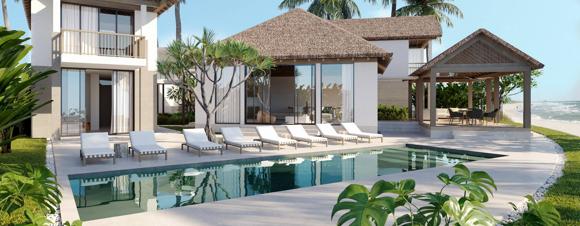
HOTEL RESERVATION ANALYSIS
BY VISHAL KUMAR GUPTA

Slide 2
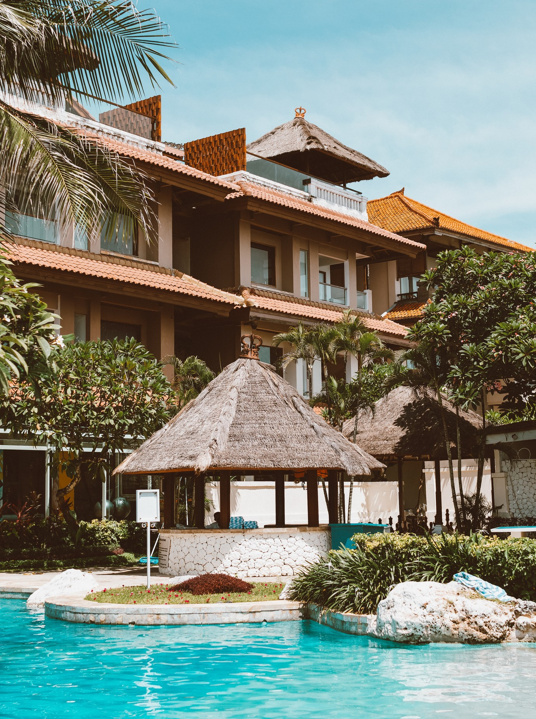

Project Overview
The hotel industry relies on data to make informed decisions and provide a better guest experience. In
this internship, you will work with a hotel reservation dataset to gain insights into guest preferences,
booking trends, and other key factors that impact the hotel's operations. You will use SQL to query and
analyze the data, as well as answer specific questions about the dataset.

Slide 3
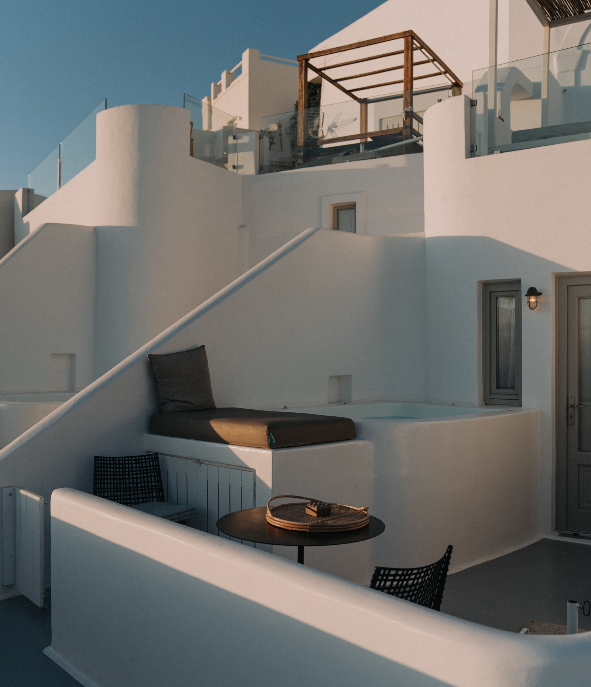
Objective
Our goal is to conduct a thorough exploration and analysis of the dataset. By answering specific questions related
to the
data, we intend to that will inform
uncover strategic
patterns
decisions and enhance the hotel's overall performance.

Slide 4

Tool Used
SQL (Structured Query Language) is a programming language designed for managing data in a relational database. It's been around since the 1970s and is the most common method of accessing data in databases today. SQL has a variety of functions that allow its users to read, manipulate, and change data.

Slide 5
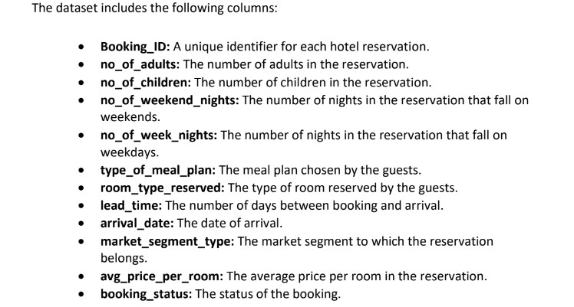
Dataset Detail

Slide 6
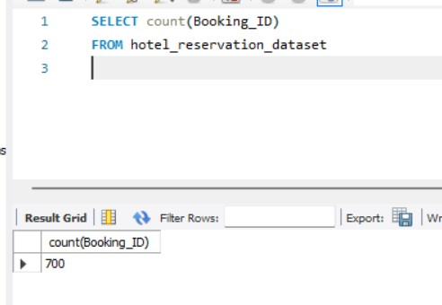
Data Analysis Queries
Query 1:
What is the total number of reservations in the dataset?
SELECT count(Booking_ID) FROM hotel_reservation_dataset
Insights: There are 700 number of reservation in the dataset.

Slide 7
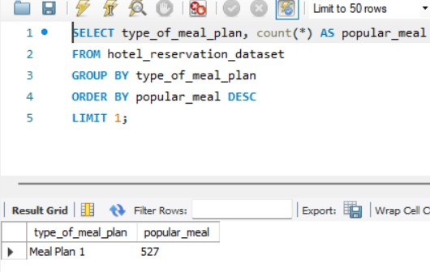
Query 2:
Which meal plan is the most popular among guests?
SELECT type_of_meal_plan, count(*) AS popular_meal
FROM hotel_reservation_dataset GROUP BY type_of_meal_plan ORDER BY popular_meal DESC LIMIT 1;
Insights: Among the following Meal Plan , Meal Plan 1 is most popular among guests.

Slide 8
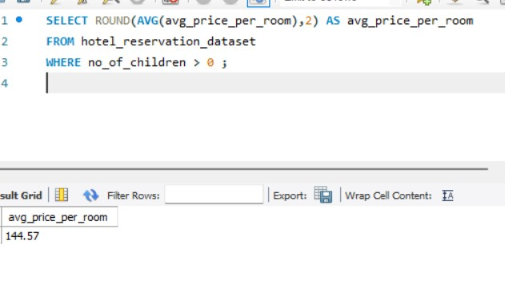
Query 3:
What is the average price per room for reservations involving children?
SELECT
ROUND(AVG(avg_price_per_room),2) AS avg_price_per_room
FROM hotel_reservation_dataset WHERE no_of_children > 0 ;
Insights: The average price per room for reservation involving children is 144.57.

Slide 9
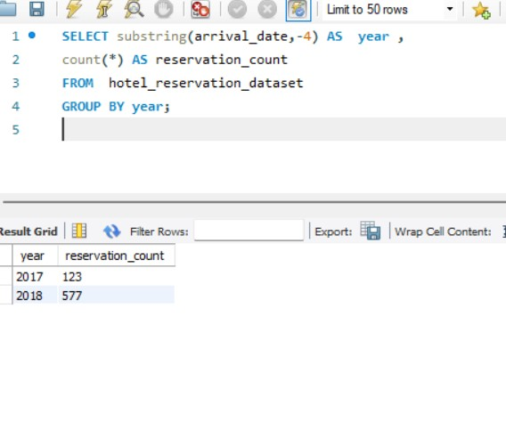
Query 4:
How many reservations were made for the year 20XX (replace XX with the desired year)?
SELECT substring(arrival_date,-4) AS year ,
count(*) AS reservation_count FROM hotel_reservation_dataset GROUP BY year;
Insights: In 2017 there are 123 reservation and in 2018 there are 577 reservation.

Slide 10
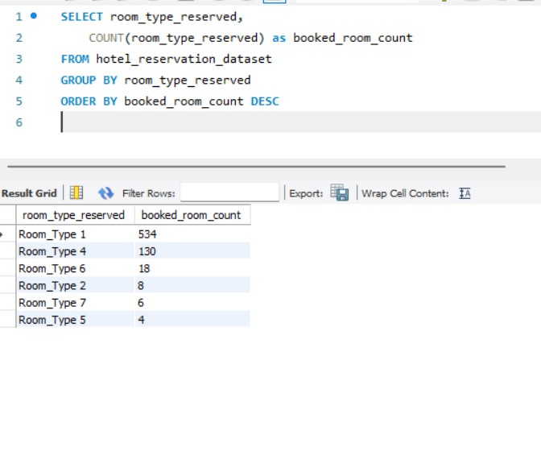
Query 5:
What is the most commonly booked room type?
SELECT room_type_reserved, COUNT(room_type_reserved) as booked_room_count
FROM hotel_reservation_dataset GROUP BY room_type_reserved ORDER BY booked_room_count DESC
Insights: Following the room type the most commonly booked room type is
Room_Type 1 which as 534 booking .

Slide 11
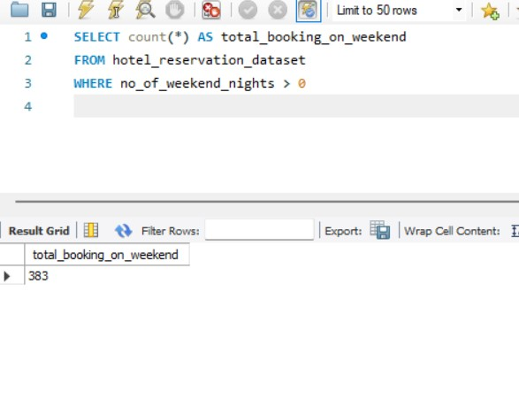
Query 6:
How many reservations fall on a weekend (no_of_weekend_nights > 0)?
SELECT count(*) AS total_booking_on_weekend FROM hotel_reservation_dataset
WHERE no_of_weekend_nights > 0
Insights: There are 383 reservation falls on a weekend.

Slide 12
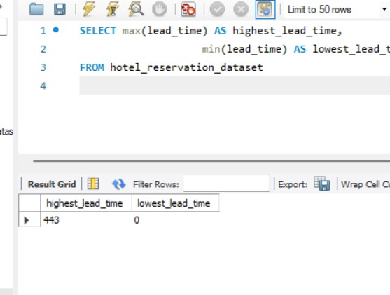
Query 7:
What is the highest and lowest lead time for reservations?
SELECT max(lead_time) AS highest_lead_time,
min(lead_time) AS lowest_lead_time
FROM hotel_reservation_dataset
Insights: The Highest Lead Time for reservation is 443 and lowest lead time for reservation is 0 .

Slide 13
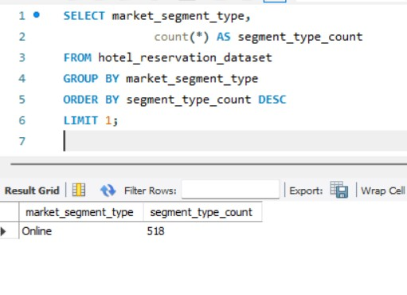
Query 8:
What is the most common market segment type for reservations ?
SELECT market_segment_type, count(*) AS segment_type_count
FROM hotel_reservation_dataset GROUP BY market_segment_type ORDER BY segment_type_count DESC LIMIT 1;
Insights: The most common market segments type for reservation is Online which is 518.

Slide 14
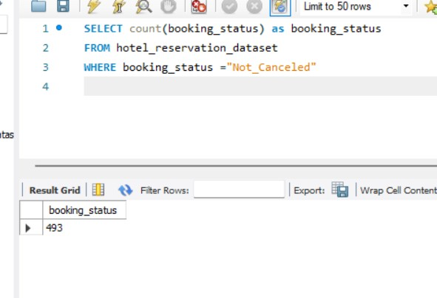
Query 9:
How many reservations have a booking status of "Confirmed"?
SELECT count(booking_status) as booking_status
FROM hotel_reservation_dataset WHERE booking_status
="Not_Canceled"
Insights: There are 483 reservation having booking status “Confirmed”.

Slide 15
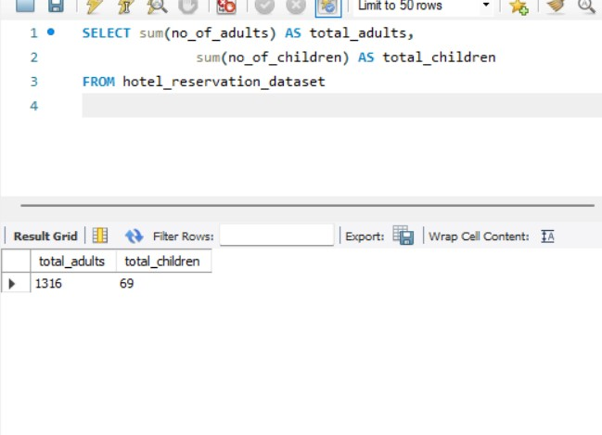
Query 10:
What is the total number of adults and children across all reservations?
SELECT sum(no_of_adults) AS total_adults,
sum(no_of_children) AS total_children
FROM hotel_reservation_dataset
Insights: The total number of adults is 1316 and children is 69.

Slide 16
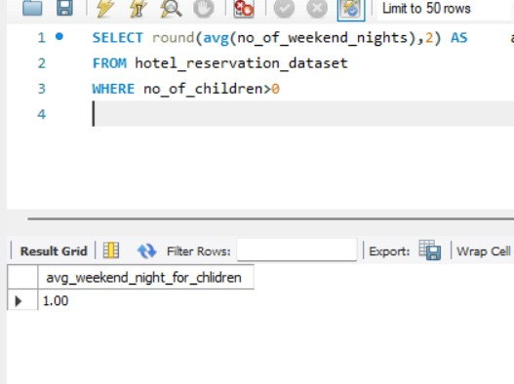
Query 11:
What is the average number of weekend nights for reservations involving children?
SELECT
round(avg(no_of_weekend_nights),2) AS avg_weekend_night_for_chlidren FROM hotel_reservation_dataset WHERE no_of_children>0
Insights: The average number of weekend nights for reservation involving children is
1.00 .

Slide 17
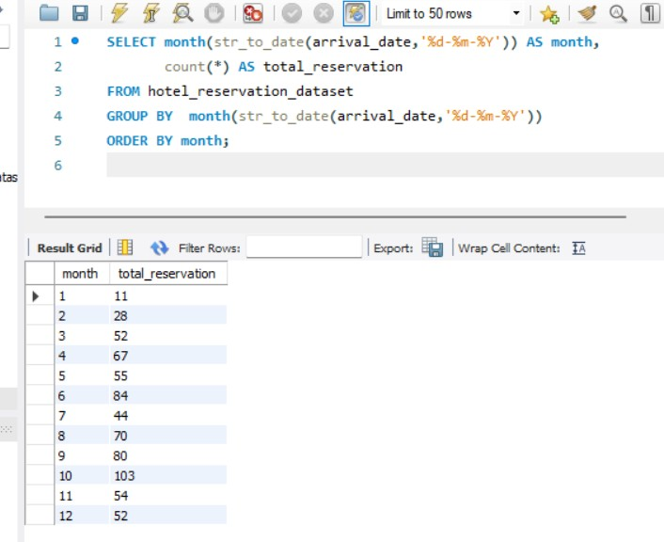
Query 12:
How many reservations were made in each month of the year?
SELECT month(str_to_date(arrival_date,'%d-
%m-%Y')) AS month,
count(*) AS total_reservation FROM hotel_reservation_dataset
GROUP BY month(str_to_date(arrival_date,'%d-
%m-%Y'))
ORDER BY month;
Insights: October has more reservation and January has Lowest number of reservation.

Slide 18
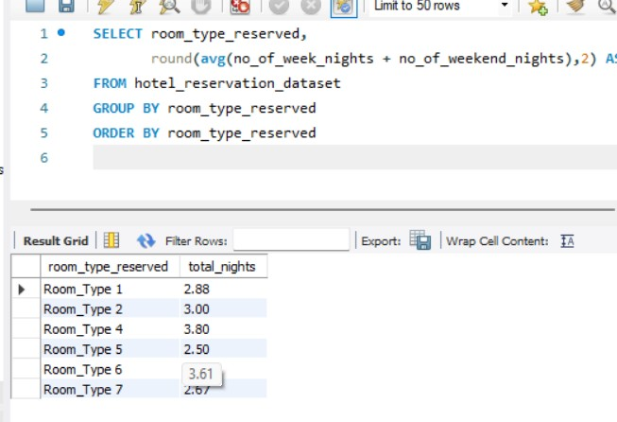
Query 13:
What is the average number of nights (both weekend and weekday) spent by guests for each room type?
SELECT room_type_reserved, round(avg(no_of_week_nights + no_of_weekend_nights),2) AS total_nights FROM hotel_reservation_dataset
GROUP BY room_type_reserved ORDER BY room_type_reserved
Insights: Room_Type 4 has more average number of night spent by guests for each room type.

Slide 19
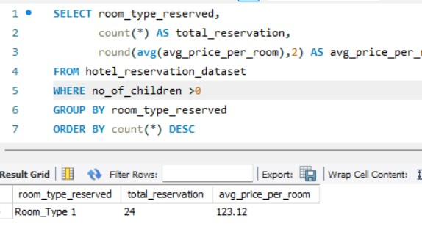
Query 14:
For reservations involving children, what is the most common room type, and what is the average price for that room type?
SELECT room_type_reserved, count(*) AS total_reservation,
round(avg(avg_price_per_room),2) AS avg_price_per_room
FROM hotel_reservation_dataset WHERE no_of_children >0 GROUP BY room_type_reserved ORDER BY count(*) DESC
LIMIT 1 ;
Insights: Room_Type 1 has 24 reservation with has average price per roon is 123.12 which is most common type.

Slide 20
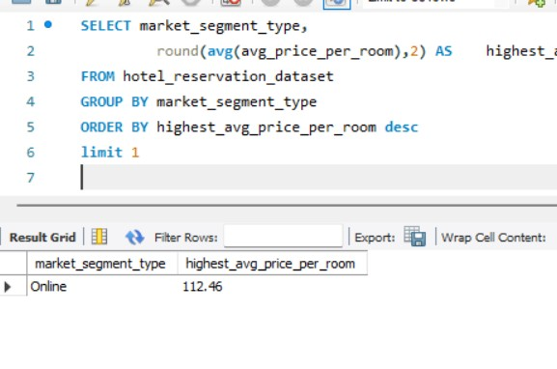
Query 15:
Find the market segment type that generates the highest average price per room.
SELECT market_segment_type, round(avg(avg_price_per_room),2) AS
highest_avg_price_per_room FROM hotel_reservation_dataset GROUP BY market_segment_type
ORDER BY highest_avg_price_per_room desc limit 1
Insights: Online market segment that generated the highest average price per room which is 112.46.

Slide 21
Recommendations
Promote Room Type 1: Offer special promotions for Room Type 1 to take advantage of its popularity.
Target Online Bookings: Focus marketing efforts on attracting online bookings, as they are the most common.
Increase January Bookings: Create partnerships or special promotions to boost reservations during quieter months like January.
Streamline Booking Processes: Improve the confirmation and booking processes to keep the high success rate of reservations.
Offer Long-Stay Packages: Introduce special deals for longer stays, especially for guests choosing Room Type 1.
Boost Weekday Promotions: Enhance services and create promotions for weekday nights, which have a strong demand (656 reservations), to attract more guests.
Last-Minute Discounts: Provide special discounts or promotions for last-minute bookings to attract more guests and reduce cancellations.
Family-Friendly Enhancements: Improve the hotel experience for families by adding special amenities and activities. Create attractive packages for one-night weekend stays for families looking for a quick getaway.
Monitor and Adapt: Continuously monitor guest preferences and market trends to adapt strategies accordingly.

Slide 22

THANK YOU SO
MUCH!

